Slide 1

A robust fixed path-based routing scheme for protecting the source location privacy in WSNs
Lingling Hu, Liang Liu*, Yulei Liu, Wenbin Zhai, Xinmeng Wang
Nanjing University of Aeronautics and Astronautics
Nanjing University _{of}
Aeronautics and Astronautics

Slide 2
Background
Since sensor nodes are usually deployed in unattended environments, privacy protection has become the challenge in WSNs. It is easy for the attackers to monitor nodes, steal messages, and obtain the location and sensitive data of the source node.
Data privacy can be protected by encryption technology.
However, due to the characteristics of WSNs’ broadcast communication, the context information is exposed and the attackers can infer the location of the source node by analyzing context information without decrypting messages.
Nanjing University _{of}
Aeronautics and Astronautics

Slide 3

Backtracking attack
Sink Node
Objective
Attacker
Source Node
Ordinary Node
Transmission Path
Nanjing University _{of}
Aeronautics and Astronautics

Slide 4
Backtracking attack
Sink Node
Objective
Attacker
Source Node
Ordinary Node
Transmission Path
Nanjing University _{of}
Aeronautics and Astronautics

Slide 5
Backtracking attack
Sink Node
Objective
Attacker
Source Node
Ordinary Node
Transmission Path
Nanjing University _{of}
Aeronautics and Astronautics

Slide 6
Backtracking attack
Sink Node
Objective
Attacker
Source Node
Ordinary Node
Transmission Path
Nanjing University _{of}
Aeronautics and Astronautics

Slide 7
Backtracking attack
Sink Node
Objective
Attacker
Source Node
Ordinary Node
Transmission Path
Nanjing University _{of}
Aeronautics and Astronautics

Slide 8
Backtracking attack
Sink Node
Objective
Attacker
Source Node
Ordinary Node
Transmission Path
Nanjing University _{of}
Aeronautics and Astronautics

Slide 9
Backtracking attack
Sink Node
Objective
Attacker
Source Node
Ordinary Node
Transmission Path
Nanjing University _{of}
Aeronautics and Astronautics

Slide 10
Backtracking attack
Sink Node
Objective
Attacker
Source Node
Ordinary Node
Transmission Path
Nanjing University _{of}
Aeronautics and Astronautics

Slide 11
Backtracking attack
Sink Node
Objective
Attacker
Source Node
Ordinary Node
Transmission Path
Nanjing University _{of}
Aeronautics and Astronautics

Slide 12
Backtracking attack
Sink Node
Objective
Attacker
Source Node
Ordinary Node
Transmission Path
Nanjing University _{of}
Aeronautics and Astronautics

Slide 13
Backtracking attack
Sink Node
Objective
Attacker
Source Node
Ordinary Node
Transmission Path
Nanjing University _{of}
Aeronautics and Astronautics

Slide 14
Backtracking attack
Sink Node
Objective
Attacker
Source Node
Ordinary Node
Transmission Path
Nanjing University _{of}
Aeronautics and Astronautics

Slide 15
Backtracking attack
Sink Node
Objective
Attacker
Source Node
Ordinary Node
Transmission Path
Nanjing University _{of}
Aeronautics and Astronautics

Slide 16
Backtracking attack
Sink Node
Objective
Attacker
Source Node
Ordinary Node
Transmission Path
Nanjing University _{of}
Aeronautics and Astronautics

Slide 17
Backtracking attack
Sink Node
Objective
Attacker
Source Node
Ordinary Node
Transmission Path
Nanjing University _{of}
Aeronautics and Astronautics

Slide 18
Backtracking attack
Sink Node
Objective
Attacker
Source Node
Ordinary Node
Transmission Path
Nanjing University _{of}
Aeronautics and Astronautics

Slide 19
Backtracking attack
The hunter can track the location of the panda by backtracking attack ! ! !
Sink Node
Objective
Attacker
Source Node
Ordinary Node
Transmission Path
Nanjing University _{of}
Aeronautics and Astronautics

Slide 20
Backtracking attack
How to protect the source location privacy (SLP) in WSNs?
Nanjing University _{of}
Aeronautics and Astronautics

Slide 21
Phantom Routing
Nanjing University _{of}
Aeronautics and Astronautics

Slide 22
Phantom Routing
Each packet is first sent by the source node to a phantom node far from the source node and then sent from the phantom node to the sink.
Nanjing University _{of}
Aeronautics and Astronautics

Slide 23
Phantom Routing
Each packet is first sent by the source node to a phantom node far from the source node and then sent from the phantom node to the sink.
PSPR
Nanjing University _{of}
Aeronautics and Astronautics

Slide 24
Phantom Routing
Each packet is first sent by the source node to a phantom node far from the source node and then sent from the phantom node to the sink.
PSPR
SRR
Nanjing University _{of}
Aeronautics and Astronautics

Slide 25
Phantom Routing
In the uniform network
Nanjing University _{of}
Aeronautics and Astronautics

Slide 26
Phantom Routing
In the uniform network
In the non-uniform network
Nanjing University _{of}
Aeronautics and Astronautics

Slide 27
Phantom Routing
Only considering the phantom node’s location and the distance from the source node does not guarantee the diversity of the transmission path certainly, which cannot protect SLP well.
In the uniform network
In the non-uniform network
Nanjing University _{of}
Aeronautics and Astronautics

Slide 28
RFRR : A Robust Fixed Path-based Random Routing Scheme
The message’s routing path consists of two parts: the fixed path of the first N hops and the shortest path after
First, RFRR selects a new fixed path that is far enough from the previous one. It ensures transmission paths’ distance between two adjacent data packets is far enough
After the fixed routing path ends, the transmission path is changed to the shortest routing path, which can reduce energy consumption while safekeeping the balance between privacy and performance
Nanjing University _{of}
Aeronautics and Astronautics

Slide 29
The Shortest Path of n_{i}
Nanjing University _{of}
Aeronautics and Astronautics

Slide 30
The Shortest Path of n_{i}
The shortest path of node n_{i} refers to the shortest path from n_{i} to Sink
The classic Dijkstra algorithm is used to calculate the shortest path
Nanjing University _{of}
Aeronautics and Astronautics

Slide 31
The Shortest Path of n_{i}
The shortest path of node n_{i} refers to the shortest path from n_{i} to Sink
The classic Dijkstra algorithm is used to calculate the shortest path
Source
U
V
W
X
Y
< source, U, V, W, X, Y, Z >
Sink
Z
Nanjing University _{of}
Aeronautics and Astronautics

Slide 32
The Fixed Path Routing
Choosing the former L-hop from the source’s shortest path as the first fixed path ( fp₁ )
Source
U
V
W
X
Y
< source, U, V, W, X, Y, Z >
Sink
Z
Nanjing University _{of}
Aeronautics and Astronautics
L = 3

Slide 33
The Fixed Path Routing
Choosing the former L-hop from the source’s shortest path as the first fixed path ( fp₁ )
Source
U
V
W
X
Y
< source, U, V, W, X, Y, Z >
Sink
Z
Nanjing University _{of}
Aeronautics and Astronautics
L = 3 >>> fp₁ = < source, U, V, W >

Slide 34
The Fixed Path Routing
Choosing the former L-hop from the source’s shortest path as the first fixed path ( fp₁ )
In order to ensure that the second fixed path fp₂ is far away from fp₁ , fp₂ needs to be constructed based on fp₁
Source
U
V
W
X
Y
< source, U, V, W, X, Y, Z >
Sink
Z
Nanjing University _{of}
Aeronautics and Astronautics
L = 3 >>> fp₁ = < source, U, V, W >

Slide 35
The Fixed Path Routing
For the i+1_{-th} node fp₂[i+1] of the fixed path fp₂ : fp₂[i] will select the node farthest from fp₁[i+1] from its neighbor nodes as fp₂[i+1]
Source
U
V
W
X
Y
Sink
Z
Nanjing University _{of}
Aeronautics and Astronautics
fp₁ = < source, U, V, W > >>> fp₁ = < source, , , >

Slide 36
The Fixed Path Routing
For the i+1_{-th} node fp₂[i+1] of the fixed path fp₂ : fp₂[i] will select the node farthest from fp₁[i+1] from its neighbor nodes as fp₂[i+1]
Source
A
U
V
W
X
Y
Sink
Z
Nanjing University _{of}
Aeronautics and Astronautics
fp₁ = < source, U, V, W > >>> fp₁ = < source, A, , >

Slide 37
The Fixed Path Routing
For the i+1_{-th} node fp₂[i+1] of the fixed path fp₂ : fp₂[i] will select the node farthest from fp₁[i+1] from its neighbor nodes as fp₂[i+1]
Source
A
U
V
B
W
X
Y
Sink
Z
Nanjing University _{of}
Aeronautics and Astronautics
fp₁ = < source, U, V, W > >>> fp₁ = < source, A, B, >

Slide 38
The Fixed Path Routing
For the i+1_{-th} node fp₂[i+1] of the fixed path fp₂ : fp₂[i] will select the node farthest from fp₁[i+1] from its neighbor nodes as fp₂[i+1]
Source
A
U
V
B
W
X
C
Y
Sink
Z
Nanjing University _{of}
Aeronautics and Astronautics
fp₁ = < source, U, V, W > >>> fp₁ = < source, A, B, C >

Slide 39
The Fixed Path Routing
For the i+1_{-th} node fp₂[i+1] of the fixed path fp₂ : fp₂[i] will select the node farthest from fp₁[i+1] from its neighbor nodes as fp₂[i+1]
Source
A
U
V
B
W
X
C
Y
Sink
Z
Nanjing University _{of}
Aeronautics and Astronautics
fp₁ = < source, U, V, W > >>> fp₁ = < source, A, B, C >

Slide 40
Experiment :
We conduct experiments in two different scenarios：
√ The uniform network
√ The non-uniform network
We set up N_{circular} obstacles with radius R_{circular} in the WSN to simulate the non-uniform network
Nanjing University _{of}
Aeronautics and Astronautics

Slide 41
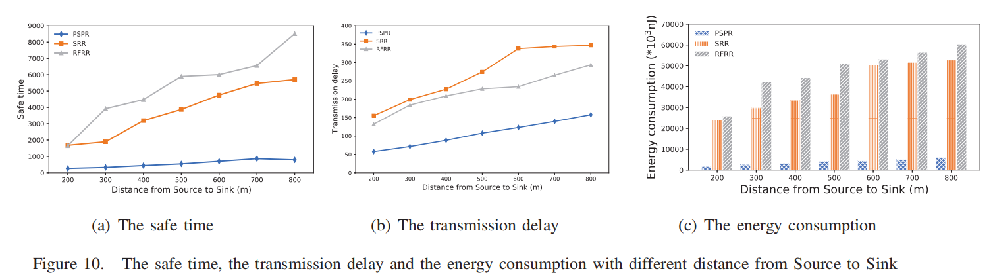
Experiment : The Uniform Network
Nanjing University _{of}
Aeronautics and Astronautics

Slide 42
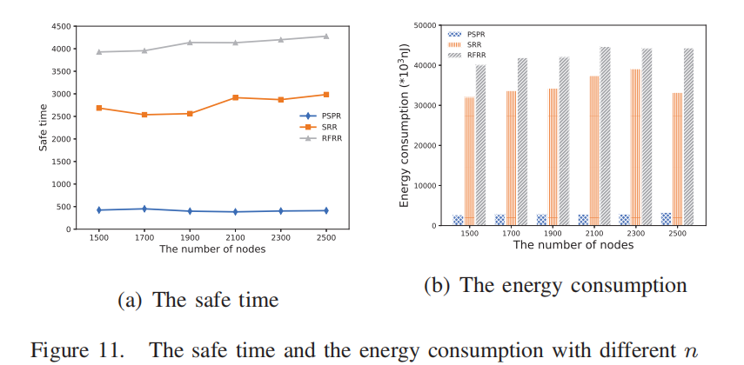
Experiment : The Uniform Network
Nanjing University _{of}
Aeronautics and Astronautics

Slide 43
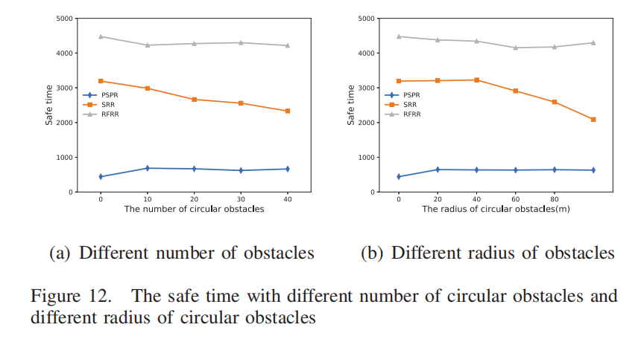
Experiment : The Non-uniform Network
Nanjing University _{of}
Aeronautics and Astronautics

Slide 44
Summary
Our paper proposes a robust fixed path-based random routing scheme(RFRR) for protecting SLP in WSNs, to solve the problem of performance degradation of existing algorithms in non-uniform networks.
The experimental results show that compared with the existing classic schemes, RFRR can guarantee higher safe time while balancing energy consumption.
Nanjing University _{of}
Aeronautics and Astronautics

Slide 45
Summary
Our paper proposes a robust fixed path-based random routing scheme(RFRR) for protecting SLP in WSNs, to solve the problem of performance degradation of existing algorithms in non-uniform networks.
The experimental results show that compared with the existing classic schemes, RFRR can guarantee higher safe time while balancing energy consumption.
Thank you !
Nanjing University _{of}
Aeronautics and Astronautics

